Slide 1

Automobile Market Analysis Project
SAMAITA MAJUMDER

Slide 2
INTRODUCTION AND OBJECTIVE
In the automobile market the manufacturers see a shift in consumers response as people are becoming more eco conscious, prioritising fuel efficiency and safety along with performance. As a data analyst out job is to analyse the dataset and present insights for the given tasks.
OBJECTIVE
Clean the dataset and perform the project tasks to identify the potential model, and present insights about the most diverse car manufacturer in the given country.
Focusing on key areas such as new product development, innovation, competitive analysis, or benchmarking.

Slide 3
SPRINT 6 Task 1
Task 2
Our job here is to identify the top 10 cars with the highest miles per hour and the manufacturers.
The list presents the top 10 unique cars with the highest mileage. Their corresponding manufacturers are also mentioned above.
Next task is to find the top 10 cars with the highest mileage based on displacement.
Make | Model | City_Mileage_km_litre
Mahindra | E2O Plus | 80
Suzuki | Dzire | 28.4
Suzuki | Ciaz | 28.09
Suzuki | Baleno | 27.39
Renault | Kwid | 25.17
Tata | Tigor | 24.12
Hyundai | Grand I10 Prime | 24
Tata | Tiago | 23.84
Suzuki | S-Cross | 23.65
Tata | Nano Genx | 23.6
Displacement | (Multiple Items)
Row Labels | Count of Sl. No.
5.3 | 1
Toyota | 1
7 | 1
Toyota | 1
7.32 | 1
Bmw | 1
7.7 | 1
Ford | 1
10 | 1
Ford | 1
12.5 | 1
Bmw | 1
13.1 | 1
Bmw | 1
13.5 | 3
Bmw | 3
Grand Total | 10
Interpretation- The pivot table shows the list of cars and the manufacturers with top 10 mileage based on displacement. We have ignore the missing values in this case and have omitted them. The manufacturers are mainly Bmw, Toyota and Ford.

Slide 4
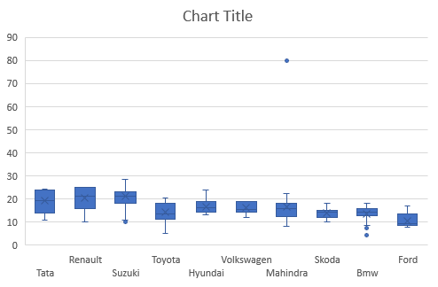
Task 4
Task 3
Next task is to identify the top 10 manufacturers with the hatchback body type.
Next we have to compare the mileage of all the cars and perform outlier analysis.
The top 3 manufacturers with the highest number of cars in the Hatchback category are- Suzuki(96),
Hyundai(46) and Tata(36).
Now from the given chart we can clearly see that seven out of the 10 manufacturers do not have any outlier when it comes to the city mileage. Mahindra, suzuki and Bmw have some outliers given by the dots in the boxplot.

Slide 5
Task 5
Task 6
Present the relationship between displacement and mileage and mileage and fuel tank capacity.
Identify a car that would be best suited for adventure.
For choosing a car for the purpose of adventure a consumer goes through various aspects like the car size, engine power, ground clearance and other safety features like airbags and hill assist.
Keeping everything in mind we have done our analysis. The best suited car for this purpose is Toyota Land cruiser with the given features below.
A negative relationship between displacement and mileage is shown using the downward trend line.
Similarly the relation between mileage and fuel tank capacity is also negative..

Slide 6
Task 7
Task 8
Our task is to identify a car suitable for family usage.
Similar to our last task we have considered various columns that a consumer would go through before buying a car for his family.
Among this we have the car size, safety features, comfort, entertainment and so on.
Based on our analysis the best option given a proper budget is a Bmw X1 model.
Next task is to compare two type of cars. A compact city car and a family car.
We already found a family car from our observation as given in task 7 :- A BMW X1.
For a family car the main focus is comfort and safety os the passengers. While a city car is one for regular travel. One that can be easily maneuvered in the city traffic with features like parking assistance. According to our analysis the best car in this category is Skoda Kodiaq.

Slide 7
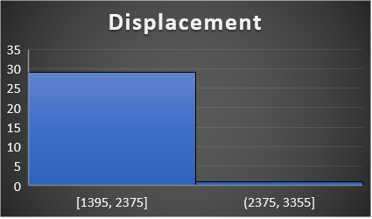
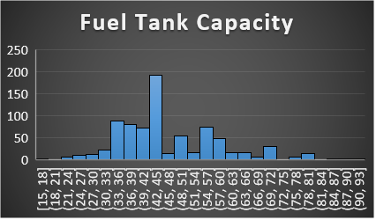
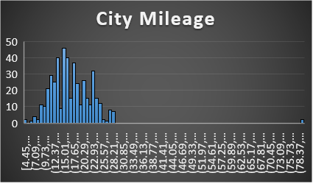
Task 9
Identify the outliers from the following columns using histogram.
Using the histogram we can find the outliers as they are mainly isolated from the main cluster of data. For example in city mileage we have an outlier at pt 80.
Manually the outliers can be found out using the IQR method. I have calculated the upper and lower fence of the three columns as given in the table. A number greater than the upper fence or smaller than the lower fence can be termed as an outlier in the data.

Slide 8
Task 10
Task 11
Identify the manufacturers with highest number of variants in the Hatchback, Sedan and Suv categories.
Find the most popular car body type, by count from the analysis of task 2.
From the analysis of task 2 were we found the top 10 cars with highest displacement based on displacement. This list also shows The body type of the given cars. From our analysis we find that Sedan is the most popular car in the top 10 cars.
The three tables shows the list of the tops 3 manufacturers with the highest number of variants in each category. For example for Hatchback the top 3 are Suzuki, Hyundai and Tata respectively.

Slide 9
Sprint 7
Task 1
Task 2
Task is to identify the top 2 manufacturers with the widest range in variants and then present the number of variants for each body type for the manufacturers.
Compare the variation of city mileage for Tata, Suzuki and Hyundai.
From our analysis the two manufacturers with the widest range of variants are Suzuki(163) and Hyundai(130). The number of variants for each body type for the two manufacturers are given below in the chart.
As measures od dispersion I have taken into account of average, variance and the standard deviation. For all the cases Suzuki has the most dispersion followed by Tata and then Hyundai.

Slide 10
Task 3
Task 4
Show the relation between city mileage and fuel tank and displacement and fuel tank.
The downward sloping trend line between city mileage and fuel tank capacity denote a negative relationship. Similarly the relationship between displacement and fuel tank is positive.
Our next task is to import and clean the dataset. Then convert the categorical values into numerical values and standardize the units.
We have already imported the dataset in excel and omitted all the null vales for the relevant columns.
For the conversion of categorical to numerical we have taken the column fuel type and using IF function assigned certain numbers for each type. For example 1 for petrol, 0 for diesel and 2 for hybrid.
For standardization I select few columns and then assigned some units for the given values using the ‘&’ function. An small section of the dataset is given below as example.
Also the fuel efficiency (average of city and highway mileage) and the distance has also been calculated by the given formula.

Slide 11
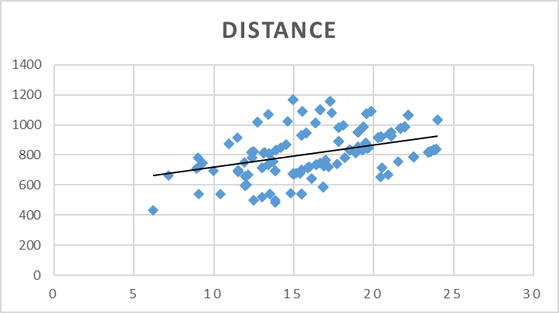
Task 5A
Task 5Ba
Visualize fuel efficiency distribution.
We have visualized the fuel efficiency across car makers, body types and fuel type in the above charts. Average mileage is taken for all the values and any null values have been omitted beforehand.
Plot average distance against fuel efficiency.
We see a positive relationship between distance and fuel efficiency from the given upward sloping trend line.
Similarly the relationships of various variable with fuel efficiency is given in the next slide.
Fuel efficiency across car manufacturers and Fuel types
Fuel efficiency across body types.

Slide 12
Task 5Bb
Present scatter plots and the correlation matrix to show the relationship between fuel efficiency and other variables.
The correlation matrix of fuel efficiency with various other columns are given below:-
We can see a similar pattern for the scatter plots and their corresponding values in the matrix. The upward sloping lines are denoted by a positive value while the downward sloping one is negative.

Slide 13
Task 5C
Segment cars into categories like high medium and low efficiency. Identify the distribution of features and point out the common features of high efficiency.
We have grouped the fuel efficiency in categories:
High Efficiency- when efficiency is more than 18.
2) Medium Efficiency- When it is between 13 and 18.
3) Low Efficiency- When it is less than 13.
Common features of high efficiency cars are high city and highway mileage and low fuel tank capacity.
The distribution of the fuel type has been grouped here based on the fuel efficiency of different cars.

Slide 14
Conclusions
From all the tasks we have performed so far, the conclusions we can draw are:-
In Sprint 6 task 1 and task 2 we focused on the top 10 cars with the highest mileage and then based on displacement. This gave us an idea about the various makers and the car models and also a list of the cars with their given mileage.
In task 3 we found out the top 3 manufacturers with the highest number of cars in the hatchback category. By using the pivot table we easily found the number of cars for each manufacturer in the selected category. Suzuki was the highest followed by Hyundai and then Tata.
Task 4 had us doing the outlier analysis using the box plot. I derived all the outliers manually using the IQR method.
In task 5 we visualized our result using the scatter plots. Mileage had a negative relation with both displacement and fuel tank capacity. So a car with more city or highway mileage tends to have less fuel capacity.
In task 6-7 we found out a suitable adventure car, family car and a compact city car respectively. This gave us an insight of the various range of cars a person can choose from according to his need or necessity.
In task 9 we did another outlier analysis but this time with a histogram.

Slide 15
Conclusion (cont)
In task 10 we found out the top 3 manufacturers with the highest number of cars in the hatchback, sedan and suv category. Our results are as follows- Hatchback-Suzuki, Hyundai and tata. Sedan-Hyundai, Skoda and Toyota. Suv- Mahindra, Hyundai and Tata.
Task 11 the most popular body type for our analysis on task 2- Sedan
In sprint 7 we observed fuel efficiency to understand driving patterns. In task 1 we found out the makes with the widest range of variants- Suzuki and Hyundai. Table and graphs are added in each slides for better understanding.
In task 2 we compared the spread od city mileage for three makers. Using variance, avg and SD we found out that Suzuki had the highest dispersion for mileage.
In task 3 we found out the correlation between city mileage and fuel tank capacity (-0.642) and displacewith and fuel tank capacity (0.7851)
In the following tasks we standardized various columns and added two new variables- Distance and fuel Efficiency.
We then grouped all the cars under three categories- High efficiency (>18), Medium Efficiency(13< &<18) and Low Efficiency (<13). Common features of High efficiency cars are high mileage and low fuel capacity.

